Slide 1

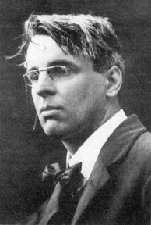
William Butler Yeats (1865-1939)

Slide 2
William Butler Yeats
The Second Coming
TURNING and turning in the widening gyre The falcon cannot hear the falconer; Things fall apart; the centre cannot hold; Mere anarchy is loosed upon the world, The blood-dimmed tide is loosed, and everywhere The ceremony of innocence is drowned; The best lack all conviction, while the worst Are full of passionate intensity.
Surely some revelation is at hand; Surely the Second Coming is at hand. The Second Coming! Hardly are those words out When a vast image out of Spiritus Mundi Troubles my sight: somewhere in sands of the desert A shape with lion body and the head of a man, A gaze blank and pitiless as the sun, Is moving its slow thighs, while all about it Reel shadows of the indignant desert birds. The darkness drops again; but now I know That twenty centuries of stony sleep Were vexed to nightmare by a rocking cradle, And what rough beast, its hour come round at last, Slouches towards Bethlehem to be born?
The Second Coming from Heroes (40.29)
http://www.cucirca.com/2008/09/23/heroes-season-3-episode-1-the-second-coming/
http://watch-heroes.net/videos/VideoS3E1.html

Slide 3
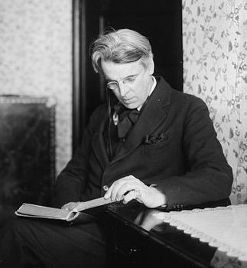
William Butler Yeats
Irish Culture and Politics
Spirituality and the Occult
Relationships with Women
Notes:
Brief history:
Ireland had been occupied by the English since the 1200s, and was officially annexed in 1800. Because land was taken from the native Irish for English and Scottish settlers, and the religion of most native Irish, Catholicism, was surpressed, there were repeated uprisings and revolts against the English throughout the centuries. By Yeats’s time, even many Irish who were Protestant descendants of English heritage (like Yeats) sought Ireland’s independence from England.

Slide 4
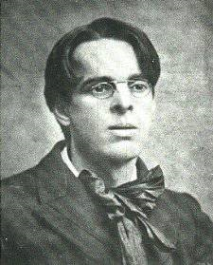
William Butler Yeats
1865-1939
born in Dublin, Ireland
Anglo-Irish (Protestant) descent
father, John Yeats, was a portrait painter and religious skeptic
family moved to London, spent summers with his mother’s family in Sligo, Ireland
Notes:
Brief history:
Ireland had been occupied by the English since the 1200s, and was officially annexed in 1800. Because land was taken from the native Irish for English and Scottish settlers, and the religion of most native Irish, Catholicism, was surpressed, there were repeated uprisings and revolts against the English throughout the centuries. By Yeats’s time, even many Irish who were Protestant descendants of English heritage (like Yeats) sought Ireland’s independence from England.

Slide 5
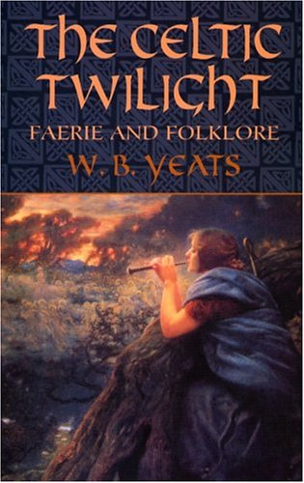
William Butler Yeats
Irish Culture and Politics
Studied Irish myth and folklore
Worked to revive Irish culture and heritage in order to promote Ireland’s movement for independence from England.
The Celtic Twilight (1893)
Irish literary revival
Abbey Theater

Slide 6
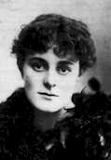

William Butler Yeats
Relationships with Women
1889 (age 24) Met and fell in unrequited love with actress Maud Gonne.
1917 (age 52) Married Georgie Hyde-Lees.

Slide 7
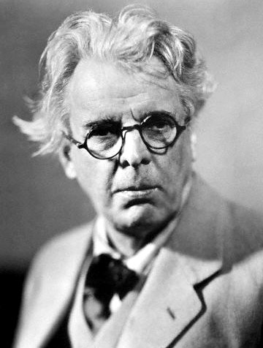
William Butler Yeats
Irish Culture
and Politics
1922 After Ireland achieved independence, he took a seat in the Irish senate.
1923 Won the Nobel prize for literature.

Slide 8
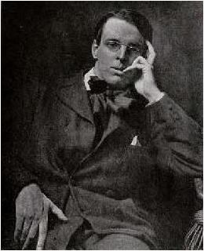
William Butler Yeats
Spirituality and the Occult
His family was Protestant, but his father was an agnostic skeptic.
Formed early interest in Irish folklore: tales of fairies, spirits, banshees, and magic.
Interest in the occult led him to join Madame Helena Blavatsky’s Theosophical Society

Slide 9
William Butler Yeats
Spirituality and the Occult
Left the Theosophical Society to be initiated into the Order of the Golden Dawn in 1890, at the age of 25.
Remained active in occult practices (magic, meditation, divination, astrology, Tarot, spiritualism/mediumship) his entire life.

Slide 10
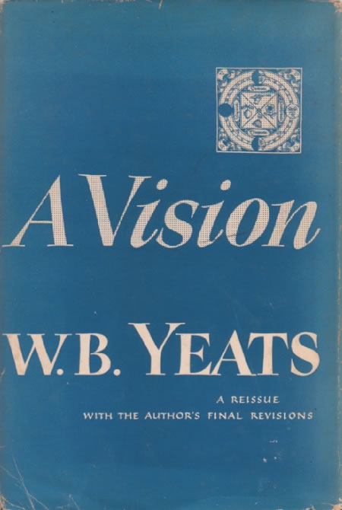
William Butler Yeats A Vision
Yeats worked on this philosophical/spiritual treatise from 1917-1931.
He was aided by his wife, George.
George would enter a trance state in which she would contact spiritual entities. Yeats would pose questions, and George/the spirits would answer via automatic writing.

Slide 11
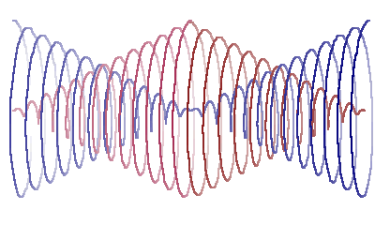
William Butler Yeats A Vision
Gyres—cycles of history that both oppose and create each other. Illustrated by overlapping, spiraling cones.
Example: the Pre-Christian, polytheistic era lead to the monotheistic, Christian era (which, according to this philosophy, is now giving way to another era).
More information: http://www.yeatsvision.com/GreatYear.html

Slide 12
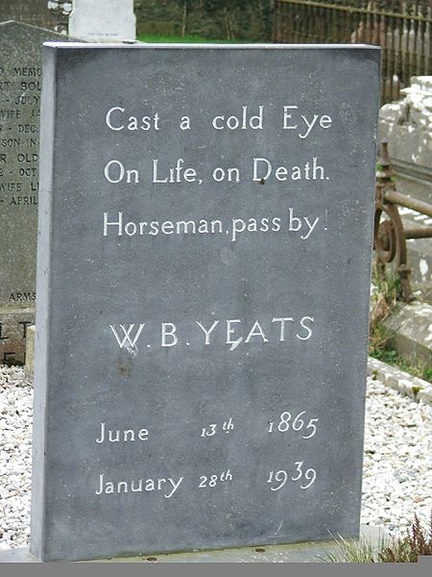
William Butler Yeats
Died in 1939 at the age of 73.

Slide 13
William Butler Yeats
Major Themes
Ireland
Love/longing
Time/aging
Poetry/art/creativity/inspiration
Spirituality/Religion/the occult

Slide 14
William Butler Yeats
“No Second Troy” (1916)
“The Second Coming” (1921)
“Leda and the Swan” (1928)

Slide 15
The fall of Troy, the founding of Rome
Zeus + Leda
(in the form of a swan)
Helen + Menelaus Agamemnon + Clytemnestra
(Greek King) (Menelaus’ brother) (kills Agamemnon)
runs away with
Iphigenia
(sacrificed by Agamemnon for success at war)
Paris of Troy
(starting the Trojan War)
resulting in Aegeus
(Trojan Prince, escaping to Italy and founding Rome)
therefore

Slide 16
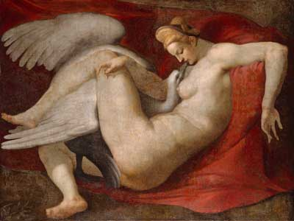
Leda and the Swan

Slide 17
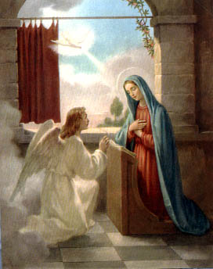
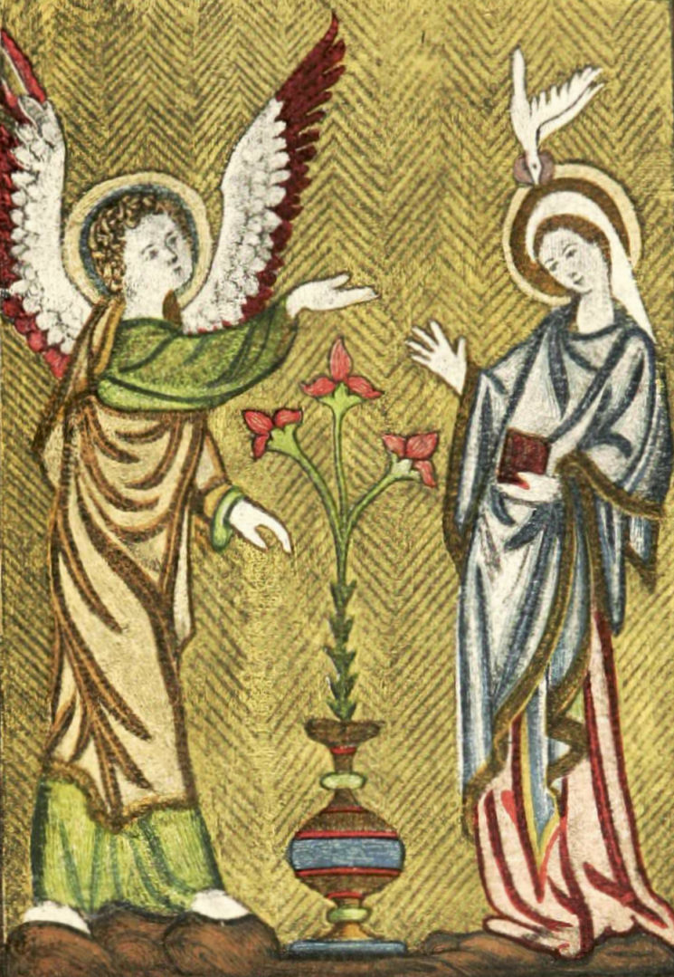
The Annunciation of Christ

Slide 18
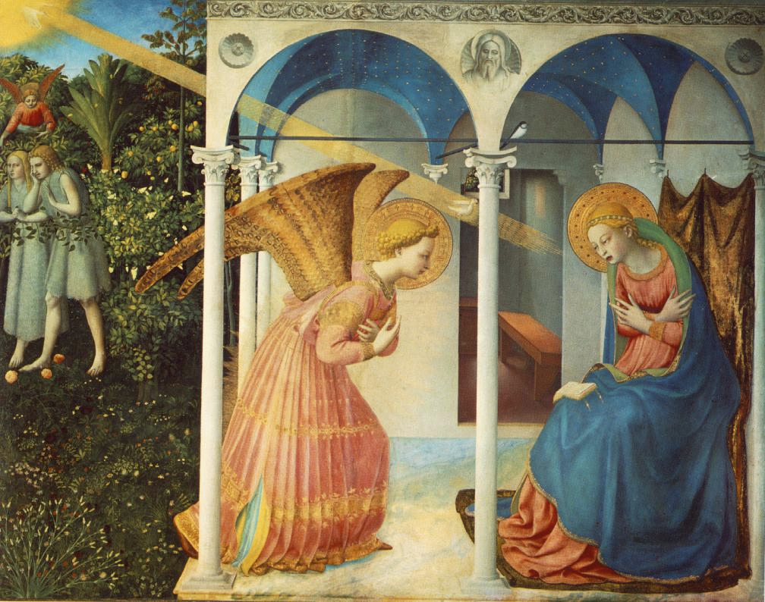
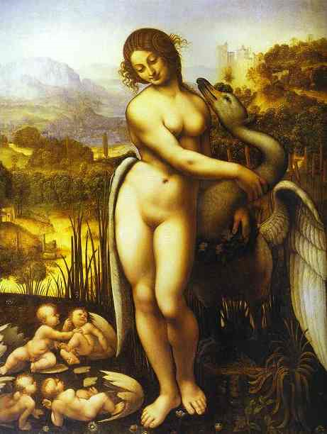
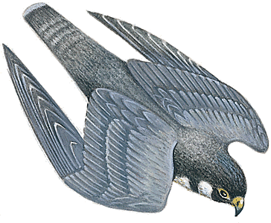
Divine birth, brought forth by a deity in the shape of a bird, heralds a new age.

Slide 19
William Butler Yeats
The Second Coming
TURNING and turning in the widening gyre The falcon cannot hear the falconer; Things fall apart; the centre cannot hold; Mere anarchy is loosed upon the world, The blood-dimmed tide is loosed, and everywhere The ceremony of innocence is drowned; The best lack all conviction, while the worst Are full of passionate intensity.
Surely some revelation is at hand; Surely the Second Coming is at hand. The Second Coming! Hardly are those words out When a vast image out of Spiritus Mundi Troubles my sight: somewhere in sands of the desert A shape with lion body and the head of a man, A gaze blank and pitiless as the sun, Is moving its slow thighs, while all about it Reel shadows of the indignant desert birds. The darkness drops again; but now I know That twenty centuries of stony sleep Were vexed to nightmare by a rocking cradle, And what rough beast, its hour come round at last, Slouches towards Bethlehem to be born?

Slide 20
William Butler Yeats
No Second Troy
WHY should I blame her that she filled my days
With misery, or that she would of late
Have taught to ignorant men most violent ways,
Or hurled the little streets upon the great,
Had they but courage equal to desire?
What could have made her peaceful with a mind
That nobleness made simple as a fire,
With beauty like a tightened bow, a kind
That is not natural in an age like this,
Being high and solitary and most stern?
Why, what could she have done being what she is?
Was there another Troy for her to burn?

Slide 21
William Butler Yeats
Leda and the Swan
A sudden blow: the great wings beating still
Above the staggering girl, her thighs caressed
By the dark webs, her nape caught in his bill,
He holds her helpless breast upon his breast.
How can those terrified vague fingers push
The feathered glory from her loosening thighs?
And how can body, laid in that white rush,
But feel the strange heart beating where it lies?
A shudder in the loins engenders there
The broken wall, the burning roof and tower
And Agamemnon dead.
Being so caught up,
So mastered by the brute blood of the air,
Did she put on his knowledge with his power
Before the indifferent beak could let her drop?

Slide 23
William Butler Yeats
Aedh wishes for the Cloths of Heaven HAD I the heavens’ embroidered cloths,
Enwrought with golden and silver light,
The blue and the dim and the dark cloths
Of night and light and the half light, I
would spread the cloths under your feet:
But I, being poor, have only my dreams;
I have spread my dreams under your feet;
Tread softly because you tread on my dreams.
“Aedh Wishes for the Cloths of Heaven” from Equilibrium
http://www.youtube.com/watch?v=os2Z_Ekg-dM

Slide 24
William Butler Yeats
Her Praise
She is foremost of those that I would hear praised. I have gone about the house, gone up and down As a man does who has published a new book, Or a young girl dressed out in her new gown, And though I have turned the talk by hook or crook Until her praise should be the uppermost theme, A woman spoke of some new tale she had read, A man confusedly in a half dream As though some other name ran in his head. She is foremost of those that I would hear praised. I will talk no more of books or the long war But walk by the dry thorn until I have found Some beggar sheltering from the wind, and there Manage the talk until her name come round. If there be rags enough he will know her name And be well pleased remembering it, for in the old days, Though she had young men's praise and old men's blame, Among the poor both old and young gave her praise.
“Her Praise” from House (39:50)
http://watch-films-online.com/2009/06/house-md-season-1-episode-6-the-socratic-method/

Slide 25
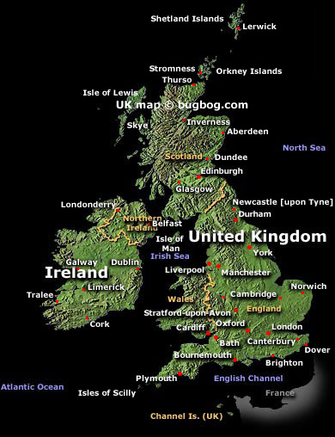
Irish Culture and Politics
Sligo
Notes:
Brief history:
Ireland had been occupied by the English since the 1200s, and was officially annexed in 1800. Because land was taken from the native Irish for English and Scottish settlers, and the religion of most native Irish, Catholicism, was surpressed, there were repeated uprisings and revolts against the English throughout the centuries. By Yeats’s time, even many Irish who were Protestant descendants of English heritage (like Yeats) sought Ireland’s independence from England.

Slide 26
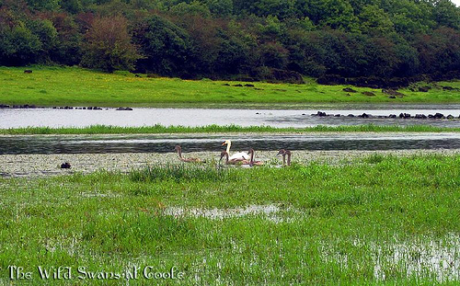
William Butler Yeats
THE WILD SWANS AT COOLE
THE trees are in their autumn beauty,
The woodland paths are dry,
Under the October twilight
the water Mirrors a still sky;
Upon the brimming water among the stones
Are nine-and-fifty swans.
The nineteenth autumn has come upon me
Since I first made my count;
I saw, before I had well finished,
All suddenly mount
And scatter wheeling in great broken rings
Upon their clamorous wings.
I have looked upon those brilliant creatures,
And now my heart is sore.
All's changed since I, hearing at twilight,
The first time on this shore,
The bell-beat of their wings above my head,
Trod with a lighter tread.
Unwearied still, lover by lover,
They paddle in the cold
Companionable streams or climb the air;
Their hearts have not grown old;
Passion or conquest, wander where they will,
Attend upon them still.
But now they drift on the still water,
Mysterious, beautiful;
Among what rushes will they build,
By what lake's edge or pool
Delight men's eyes when I awake some day
To find they have flown away?

Slide 27
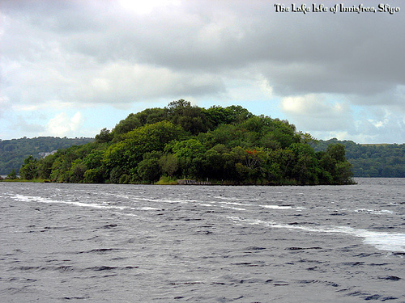
William Butler Yeats
THE LAKE ISLE OF INNISFREE
I will arise and go now, and go to Innisfree, And a small cabin build there, of clay and wattles made; Nine bean rows will I have there, a hive for the honeybee, And live alone in the bee-loud glade.
And I shall have some peace there, for peace comes dropping slow, Dropping from the veils of the morning to where the cricket sings; There midnight's all a-glimmer, and noon a purple glow, And evening full of the linnet's wings.
I will arise and go now, for always night and day I hear the water lapping with low sounds by the shore; While I stand on the roadway, or on the pavements gray, I hear it in the deep heart's core.

