Slide 1
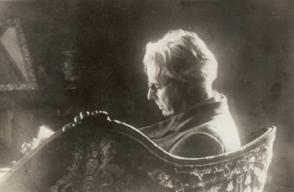
Yeats and Ireland

Slide 2
1558 Queen Elizabeth I
OATH OF SUPREMACY I, A. B., do utterly testify and declare in my conscience, that the Queen's highness is the only supreme governor of this realm, and of all other her Highness dominions and countries, as well in all spiritual or ecclesiastical things or causes, as temporal, and that no foreign prince, person, prelate, state or potentate, hath, or ought to have any jurisdiction, power, superiority, preheminence, or authority ecclesiastical or spiritual, within this realm; and therefore I do utterly renounce and forsake all foreign jurisdictions, powers, superiorities, and authorities, and do promise that from henceforth I shall bear faith and true allegiance to the Queen's Highness, her heirs and lawful successors, and to my power shall assist and defend all jurisdictions, preheminences, privileges and authorities granted or belonging to the Queen's Highness, her heirs and successors, or united and annexed to the imperial crown of this realm. So help me God, and by the contents of this book.‘
Penal Laws

Slide 3
1691 King William and Queen Mary
I, A.B., do solemnly and sincerely, in the presence of God, profess, testify, and declare, that I do believe that in the sacrament of the Lord's Supper there is not any transubstantiation of the elements of bread and wine into the body and blood of Christ at or after the consecration thereof by any person whatsoever, and that the invocation or adoration of the virgin Mary or any other saint, and the sacrifice of the mass, as they are now used in the church of Rome, are superstitious and idolatrous.

Slide 4
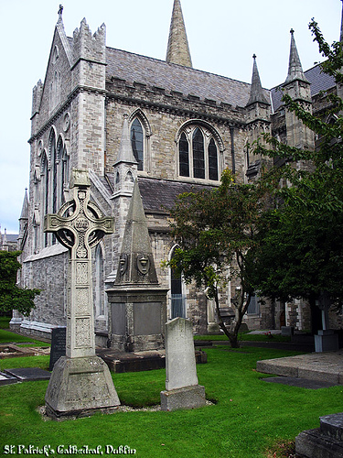
Catholic cathedrals and churches were taken and converted to Church of Ireland (protestant) churches.

Slide 5
1691 King William and Queen Mary
OATH OF ALLEGIANCE I, A.B. do sincerely promise and swear that I will be faithful and bear true allegiance to their Majesties King William and Queen Mary, So help me God. OATH OF ABHORRENCE I, A.B., do swear, that I do from my heart abhor, detest, and abjure as impious and heretical, that damnable doctrine and position, that princes excommunicated or deprived by the pope or any authority of the See of Rome, may be deposed or murdered by their subjects, or any other person whatsoever, and I do declare, that no foreign prince, prelate, state, or potentate, hath or ought to have any jurisdiction, power, superiority, pre-eminence, or authority, ecclesiastical or spiritual, within this realm.

Slide 6
Penal Laws
1607 Catholics forbidden to hold most public offices
Protestants forbidden to marry Catholics (repealed 1778 )
Presbyterian marriages were not legally recognized
Catholics forbidden to own guns or serve in the military (repealed 1793)
1652 Catholics barred from Parliament of Ireland or the Parliament of Great Britain (rescinded 1662-1691; renewed 1691-1829)
1695 Catholics forbidden to send children to foreign schools and colleges (repealed 1782) Catholics barred from Trinity College Dublin (repealed 1793)
1728 Catholics barred from voting and the legal profession (repealed 1793) and the judiciary ( repealed 1829)
Protestants forbidden to convert to Catholicism: penalty included forfeiting all property and jail sentence

Slide 7
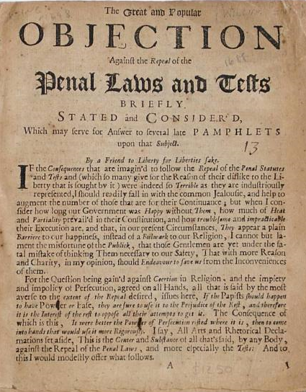
Penal Laws
Catholics forbidden to contract to lease land for more than 31 years (repealed 1778)
Catholics forbidden to adopt orphaned children
Catholics barred from inheriting land from Protestants
Catholics forbidden to own a horse worth more than £5
Catholics forbidden to become teachers
Catholic children barred from education

Slide 8
Home Rule and Full Independence
Home Rule
Republicanism
(Full Independence)
Home Rule: Support for an Irish Parliament to rule affairs within Ireland, rather than simply having Irish representatives in the British Parliament. Home Rule would not include political separation from Britain.
Independence: Support for Ireland as a fully independent, sovereign nation with no political allegiance to Britain.

Slide 9
Support for Home Rule or independence was common among Irish Catholics for obvious reasons, but many protestants, both in Ireland and England, also supported some measure of independence for Ireland.
Peace: an end to the uprisings and violence
Sympathy for Catholics
Patriotism for Ireland

Slide 10
Achieving Independence
Political
Parliament
Cultural
Reviving Gaelic
Revolutionary
Irish Republican Brotherhood (later, the IRA)
Irish Volunteers
Elections
Irish Folklore
Art and Literature
Irish Sports
Irish Citizen Army
Treaty Negotiations

Slide 11
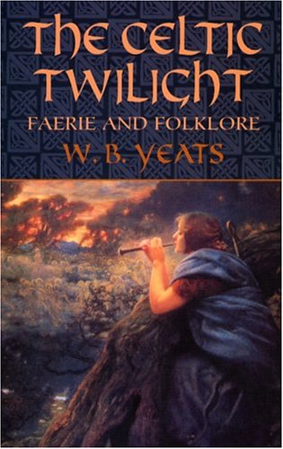
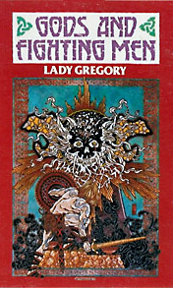
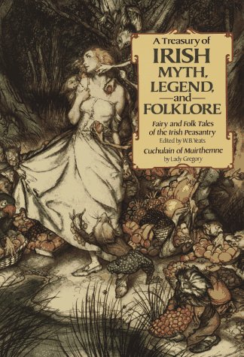
Irish Literary Revival

Slide 12
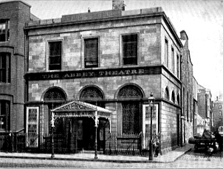
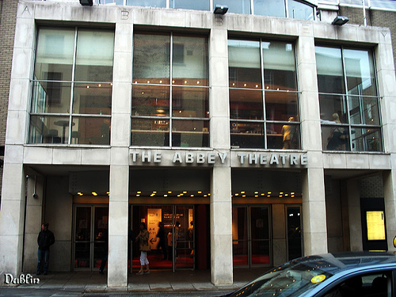
Abbey Theatre

Slide 13
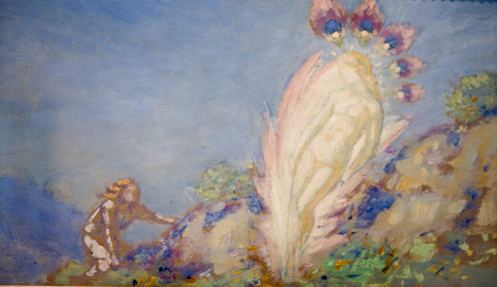
Irish Faery Paintings by George Russell (AE)

Slide 14
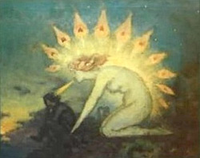
Irish Faery Paintings by George Russell (AE)

Slide 15
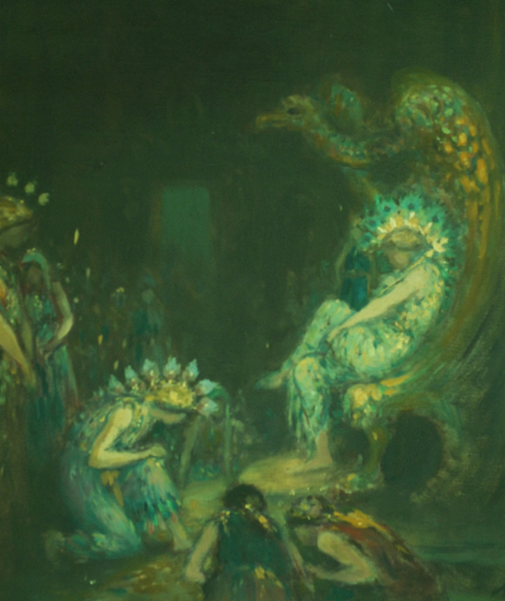
Irish Faery Paintings by George Russell (AE)

Slide 16
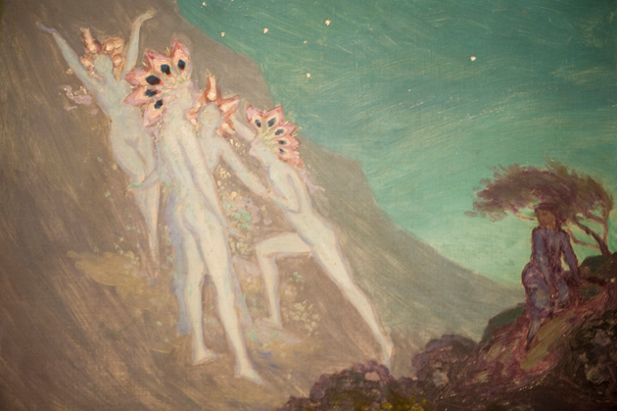
Irish Faery Paintings by George Russell (AE)

Slide 17
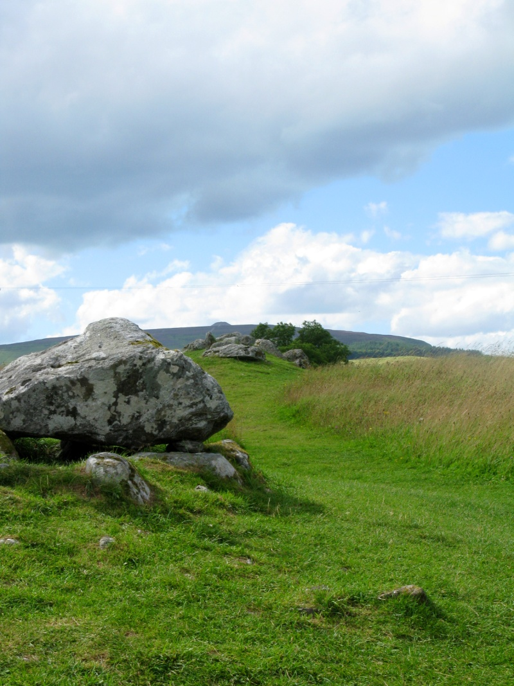
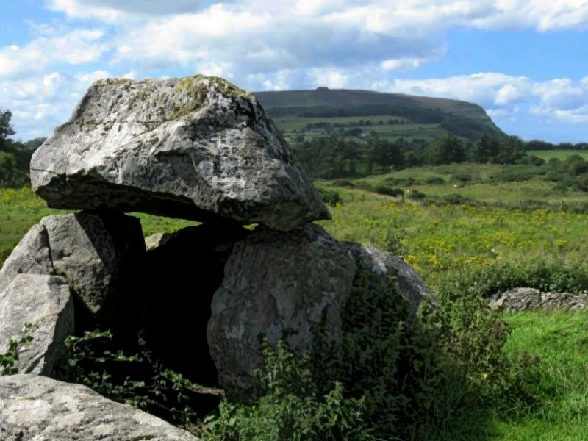
Carramore Tombs and Knocknarea

Slide 18
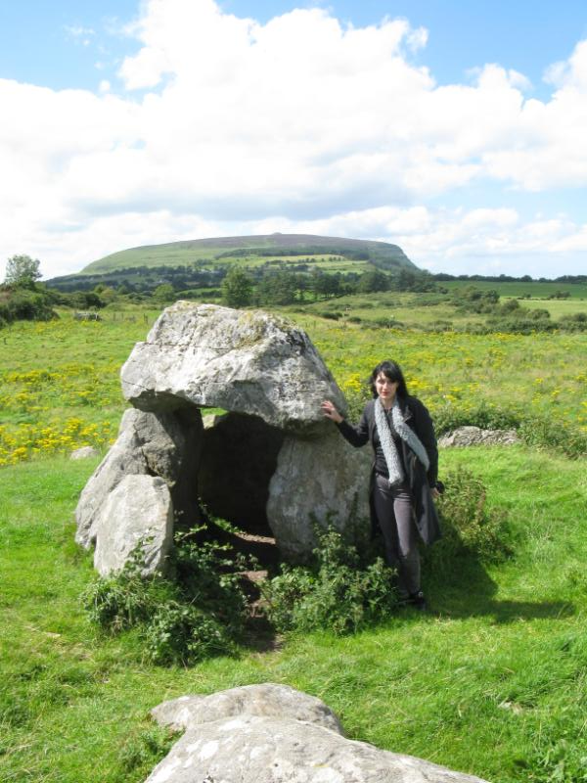
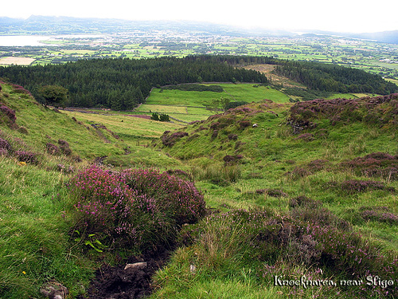

Slide 19
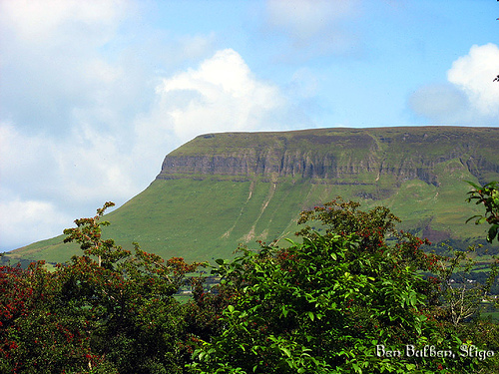
Ben Bulben in Sligo

Slide 20
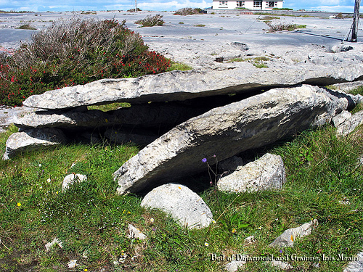
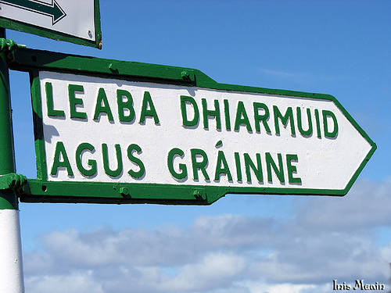
Tomb of Dharmuid and Grainne on Inis Meain

Slide 21
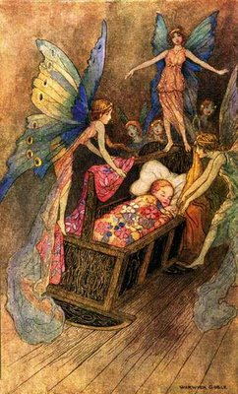
The Stolen Child (1889)
http://childillustration.blogspot.com/2009_02_01_archive.html

Slide 22
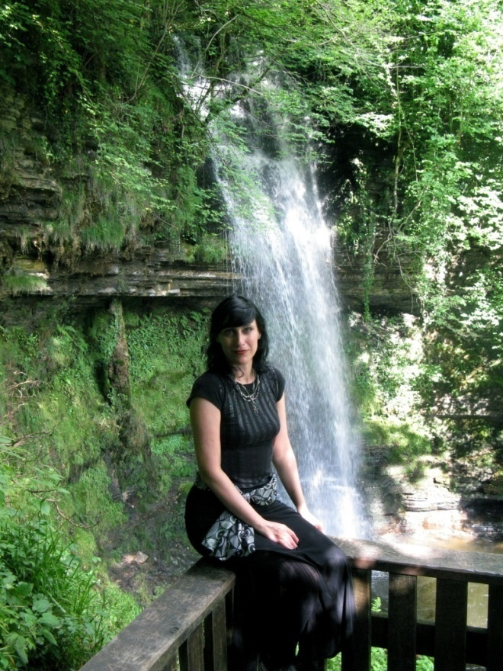
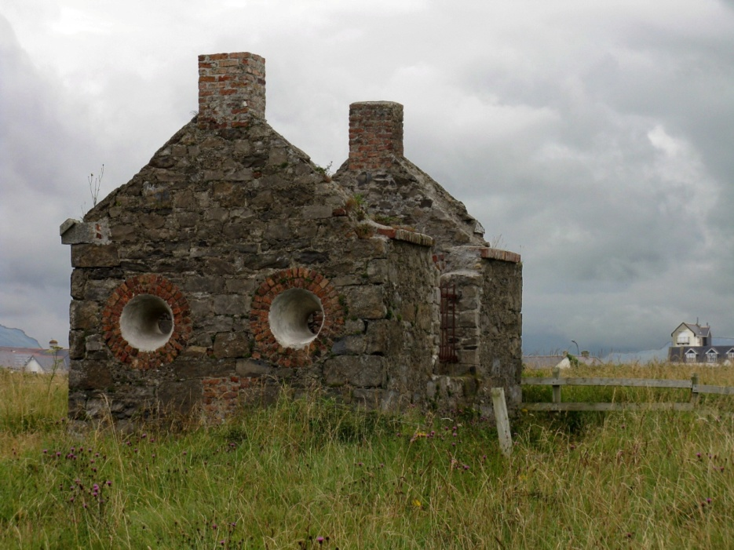
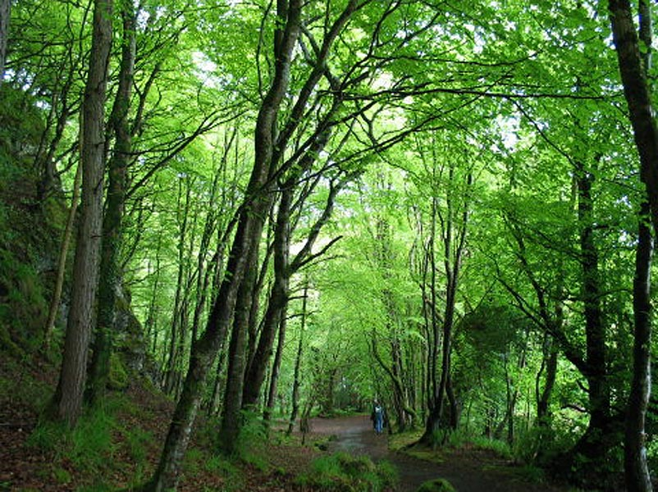
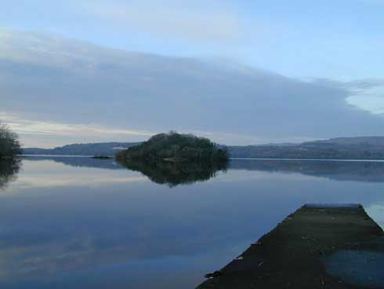
Rosses Point (ruined cottage near the beach)
Glencar Waterfall
Lake Isle of Innisfree
Sleuth Wood

Slide 23
Where dips the rocky highland Of Sleuth Wood in the lake
There lies a leafy island Where flapping herons wake
The drowsy water-rats; There we've hid our faery vats
Full of berries And the reddest stolen cherries.
Come away, O human child! To the waters and the wild With a faery hand in hand, For the world's more full of weeping than you can understand.
Where the wave of moonlight glosses The dim grey sands with light, Far off by furthest Rosses We foot it all the night, Weaving olden dances, Mingling hands and mingling glances Till the moon has taken flight; To and fro we leap And chase the frothy bubbles, While the world is full of troubles And is anxious in its sleep.
Come away, O human child! To the waters of the wild With a faery hand in hand, For the world's more full of weeping than you can understand.
Where the wandering water gushes From the hills above Glen-Car, In pools among the rushes That scarce could bathe a star, We seek for slumbering trout And whispering in their ears Give them unquiet dreams; Leaning softly out From ferns that drop their tears Over the young streams.
Come away, O human child! To the waters and the wild With a faery hand in hand, For the world's more full of weeping than you can understand.
Away with us he's going, The solemn-eyed: He'll hear no more the lowing Of the calves on the warm hillside Or the kettle on the hob Sing peace into his breast, Or see the brown mice bob Round and round the oatmeal-chest. For he comes, the human child, To the waters and the wild With a faery hand in hand, From a world more full of weeping than he
can understand.

Slide 24
The Song of Wandering Aengus (1899)

Slide 25
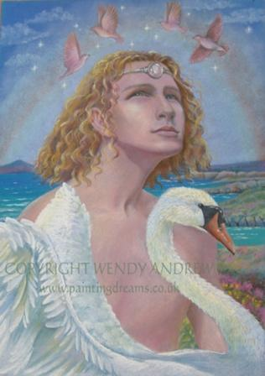
Aengus by Wendy Andrews (contemporary artist)
Aengus was the Irish god of love.

Slide 26
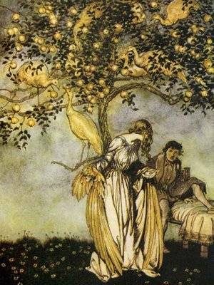
I went out to the hazel wood,
Because a fire was in my head,
And cut and peeled a hazel wand,
And hooked a berry to a thread;
And when white moths were on the wing,
And moth-like stars were flickering out,
I dropped the berry in a stream
And caught a little silver trout.
When I had laid it on the floor
I went to blow the fire a-flame,
But something rustled on the floor,
And some one called me by my name:
It had become a glimmering girl
With apple blossom in her hair
Who called me by my name and ran
And faded through the brightening air.
Though I am old with wandering
Through hollow lands and hilly lands,
I will find out where she has gone,
And kiss her lips and take her hands;
And walk among long dappled grass,
And pluck till time and times are done
The silver apples of the moon,
The golden apples of the sun.
http://childillustration.blogspot.com/2009_02_01_archive.html

Slide 27
What in these two poems might indicate that they are more than simply children’s fairy tales? What other, deeper meanings are hinted at?

Slide 28
Political Struggle

Slide 29
World War I (1914-1918)
Many Irish volunteered to fight for England
Others viewed the war as an opportunity to fight for independence while England was weak.
England’s decision to begin conscription of the Irish (drafting them to fight) in 1918 furthered the Irish movement for independence.

Slide 30
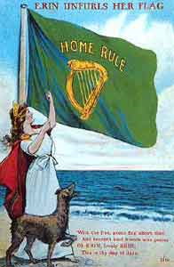
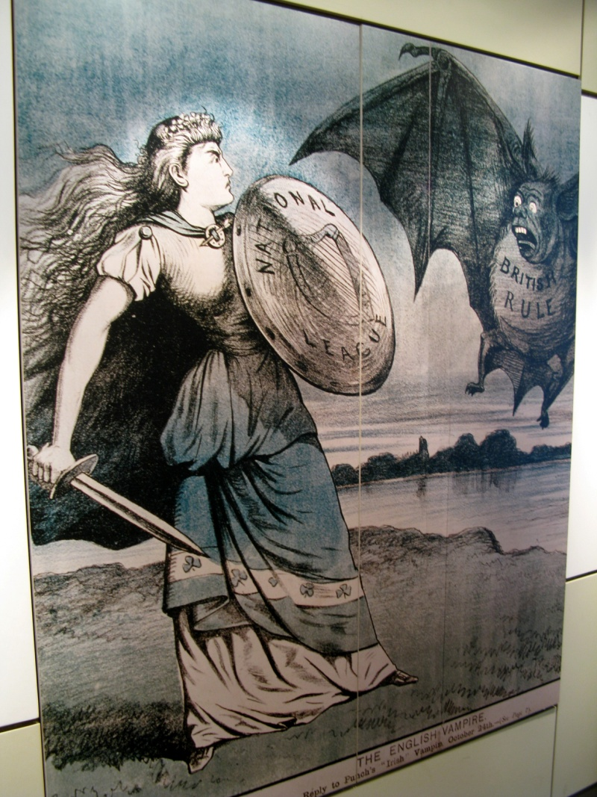
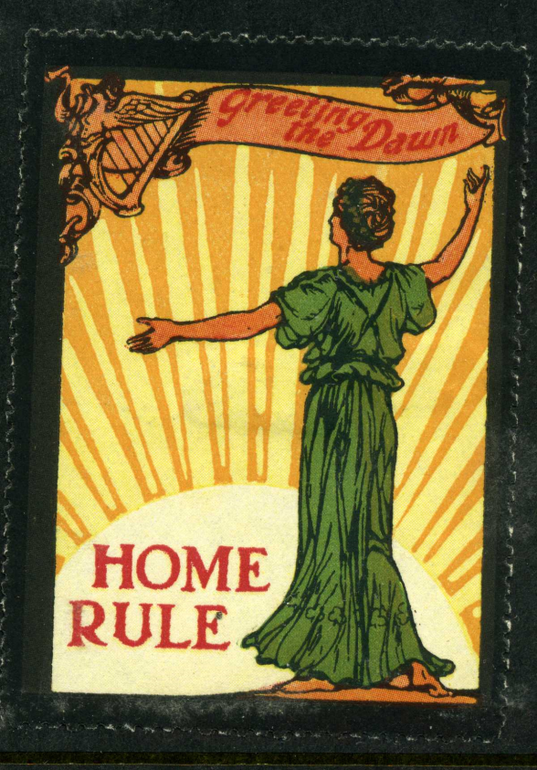

Slide 31
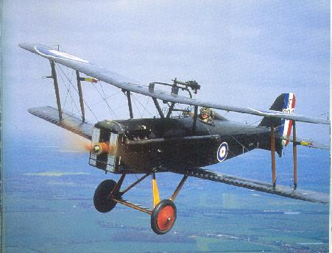
An Irish Airman Forsees his Death (1919)
http://www.psywarrior.com/BritishPlaneWWI.jpg

Slide 32
I know that I shall meet my fate
Somewhere among the clouds above;
Those that I fight I do not hate,
Those that I guard I do not love;
My country is Kiltartan Cross,
My countrymen Kiltartan's poor,
No likely end could bring them loss
Or leave them happier than before.
Nor law, nor duty bade me fight,
Nor public men, nor cheering crowds,
A lonely impulse of delight
Drove to this tumult in the clouds;
I balanced all, brought all to mind,
The years to come seemed waste of breath,
A waste of breath the years behind
In balance with this life, this death

Slide 33
Easter Rising, 1916

Slide 34
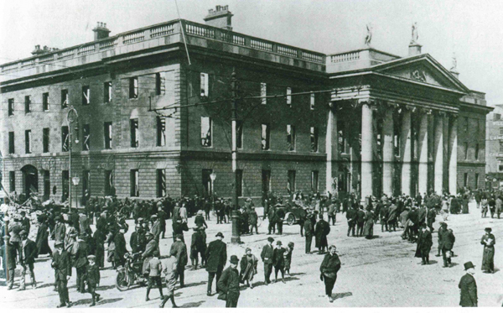
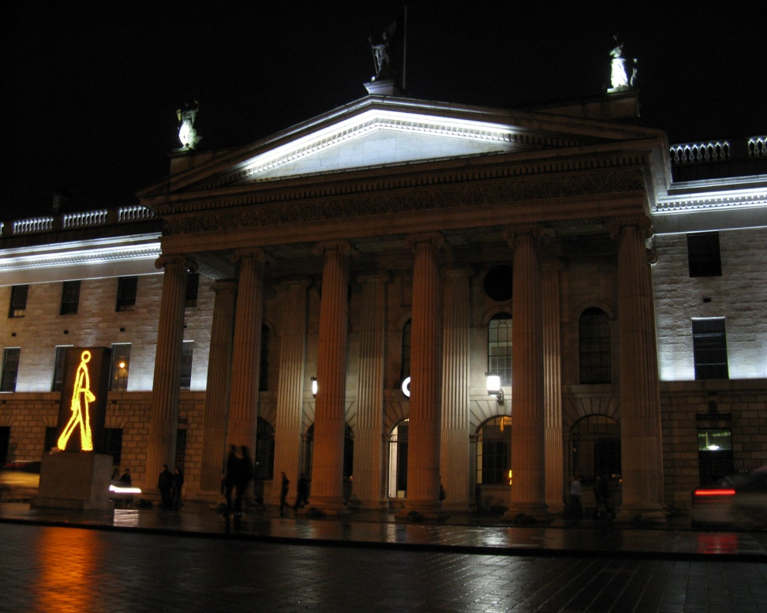
Dublin Post Office

Slide 35
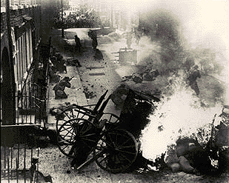
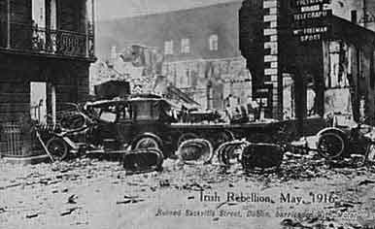

Slide 36
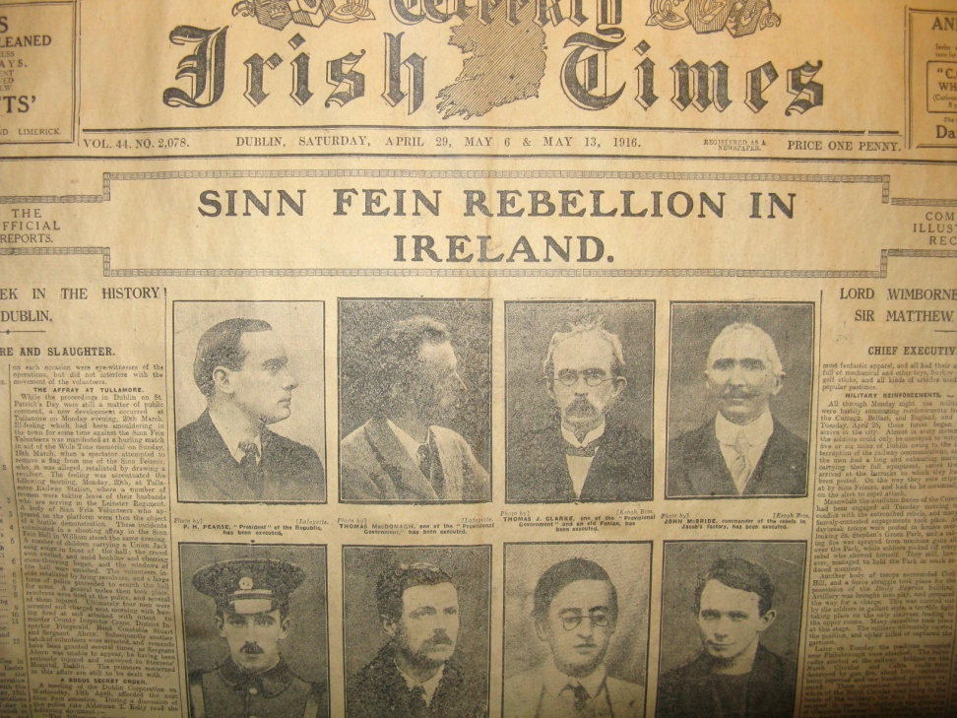
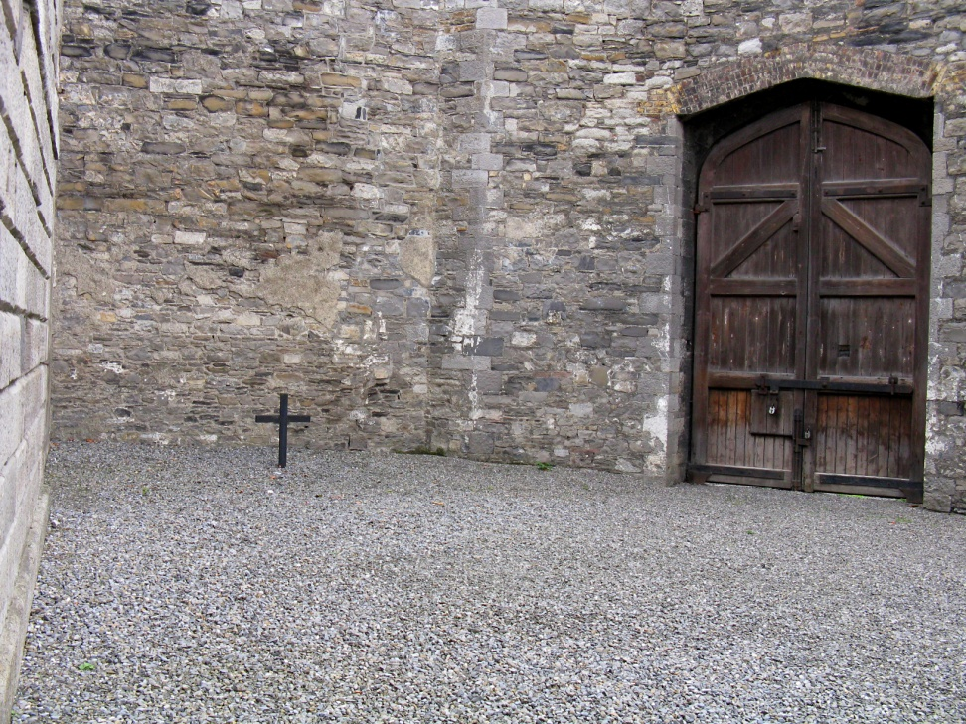
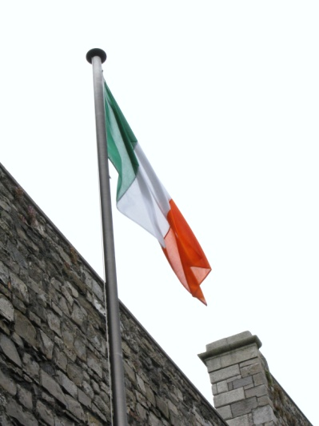

Slide 37
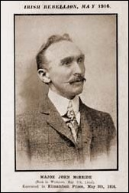
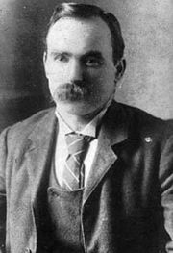
John MacBride: Fought under MacDonough in Rising, husband of Maud Gonne
James Connolly: Irish Socialist Republican Party, Irish Citizen Army

Slide 38
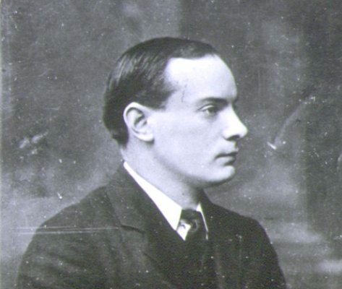
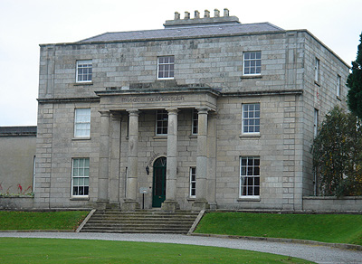
Padraig Pearse: Schoolmaster, Irish Republican Brotherhood, Irish Volunteers
St. Enda’s School

Slide 39
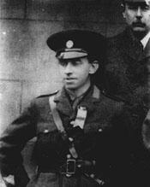
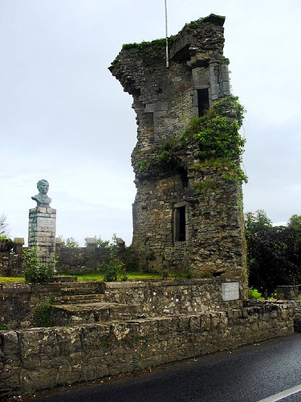
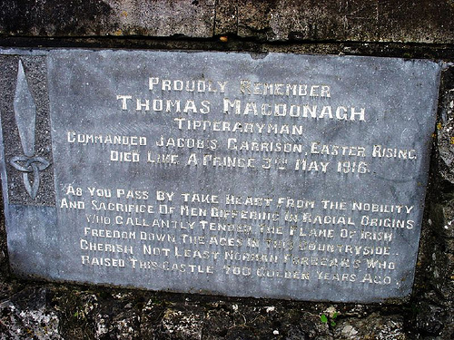
Thomas MacDonough:
Poet, Schoolteacher

Slide 40
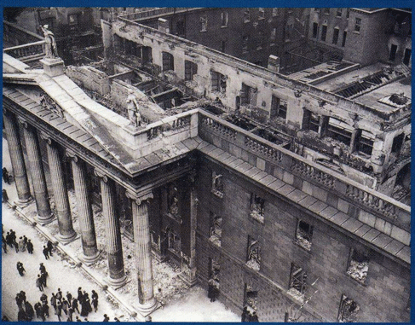
Easter, 1916 (1916)

Slide 41
That woman's days were spent In ignorant good will, Her nights in argument Until her voice grew shrill. What voice more sweet than hers When young and beautiful, She rode to harriers? This man had kept a school And rode our winged horse. This other his helper and friend Was coming into his force; He might have won fame in the end, So sensitive his nature seemed, So daring and sweet his thought. This other man I had dreamed A drunken, vain-glorious lout. He had done most bitter wrong To some who are near my heart, Yet I number him in the song; He, too, has resigned his part In the casual comedy; He, too, has been changed in his turn, Transformed utterly: A terrible beauty is born.
I have met them at close of day Coming with vivid faces From counter or desk among grey Eighteenth-century houses. I have passed with a nod of the head Or polite meaningless words, Or have lingered awhile and said Polite meaningless words, And thought before I had done Of a mocking tale or a gibe To please a companion Around the fire at the club, Being certain that they and I But lived where motley is worn: All changed, changed utterly: A terrible beauty is born.

Slide 42
Too long a sacrifice Can make a stone of the heart. O when may it suffice? That is heaven's part, our part To murmur name upon name, As a mother names her child When sleep at last has come On limbs that had run wild. What is it but nightfall? No, no, not night but death. Was it needless death after all? For England may keep faith For all that is done and said. We know their dream; enough To know they dreamed and are dead. And what if excess of love Bewildered them till they died? I write it out in a verse -- MacDonagh and MacBride And Connolly and Pearse Now and in time to be, Wherever green is worn, Are changed, changed utterly: A terrible beauty is born.
Hearts with one purpose alone Through summer and winter, seem Enchanted to a stone To trouble the living stream. The horse that comes from the road, The rider, the birds that range From cloud to tumbling cloud, Minute by minute change. A shadow of cloud on the stream Changes minute by minute; A horse-hoof slides on the brim; And a horse plashes within it Where long-legged moor-hens dive And hens to moor-cocks call. Minute by minute they live: The stone's in the midst of all.

